Slide 1
Lecture 6 Arithmetic
Tian Sheuan Chang

Slide 2
Signed and unsigned Addition and multiplication

Slide 3
Negative Integers
Thus far we have only addressed positive integers. What about negative numbers?
3 ways to represent negative integers in binary:
Sign Magnitude
One’s complement
Two’s complement
Example: Consider +23 –23
Sign Magnitude 0 10111 1 10111
One’s complement 0 10111 1 01000
Two’s complement 0 10111 1 01001
Sign bit

Slide 4
Why do we all use 2’s complement?
2’s complement makes subtraction easy
Represent negative number, –x as 2^{n} – x
All arithmetic is done modulo 2^{n} so no adjustments are necessary
x + (– y) = x + (2^{n} – y) (mod 2^{n})
consider 4-bit numbers
4 – 3 = 4 + (16 – 3) (mod 16) = 4 + (15 – 3 + 1) = 0100 + (1111 – 0011) + 0001 = 0100 + 1100 + 0001 = 0001
Notes:
舉例說明 -7 = 8-7 =1 = 001 + sign bit = 1001
2’s complement 0111 => 1001
16-3 = 15-3 + 1 (2’s complement form)

Slide 5
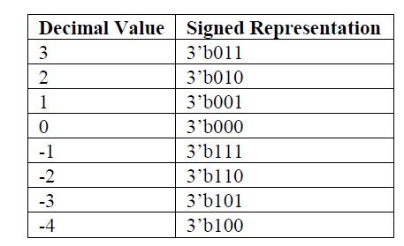
Signed data types (after Verilog-2001)
Type casting
A = $signed(B) //sign extension of sign bit
A = $unsigned(B) //zero fill B and assign it to A
Signed Based Values
3’sh2 //3-bit signed hex value
-3’sh4 //3-bit signed hex value
A decimal number is always signed
logic signed [5:0] a;
logic [2:0] b;
b = 3’b101;
a = $signed(101); //a = 111_101;
a= $unsigned(101); //a = 000_101;
2’s complement
Notes:
舉例 sign extension -3 (5-bit) a(6bit) = $signed(101)
A = $unsigned(B) will zero fill B and assign it to A. Casting using $signed(signal_name) will sign extend the input. For example, A = $signed(B). If the sign bit is X or Z the value will be sign extended using X or Z, respectively. Assigning to a smaller bit width signal will simply truncate the necessary MSB’s as usual. Casting to the same bit width will have no effect other than to remove synthesis warnings.

Slide 6
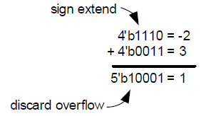
無號數及有號數的乘加運算電路 (DIY Sign Extension in Verilog)
設計一個電路計算a * b + c，
mode=0時，採用unsigned operation，
mode=1時，採用signed operation

Slide 7
Sign Extension in Verilog for Addition
module add_signed_1995 (
input [2:0] A,
input [2:0] B,
output [3:0] Sum
);
assign Sum = {A[2],A} + {B[2],B};
endmodule // add_signed_1995
module add_signed_2001 (
input signed [2:0] A,
input signed [2:0] B,
output signed [3:0] Sum
);
assign Sum = A + B;
endmodule // add_signed_2001
Mixed signed/unsigned operation is regarded as unsigned
use $signed for type casting
You have to deal with sign extension by yourself in Verilog 1995
Use signed for auto handling
module add_carry_signed_final (
input signed [2:0] A,
input signed [2:0] B,
input carry_in,
output signed [3:0] Sum
);
assign Sum = A + B + $signed({1'b0,carry_in});
endmodule // add_carry_signed_2001
carry_in is unsigned, add “0” before type casting
http://www.tumbush.com/published_papers/Tumbush%20DVCon%2005.pdf
Notes:
http://www.tumbush.com/published_papers/Tumbush%20DVCon%2005.pdf

Slide 8
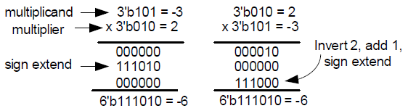
Sign Extension in Verilog for Multiplication
module mult_signed_1995 (
input [2:0] a,
input [2:0] b,
output [5:0] prod
);
wire [5:0] prod_intermediate0;
wire [5:0] prod_intermediate1;
wire [5:0] prod_intermediate2;
wire [2:0] inv_add1;
assign prod_intermediate0 = b[0] ? {{3{a[2]}}, a} : 6'b0;
assign prod_intermediate1 = b[1] ? {{2{a[2]}}, a, 1'b0} : 6'b0;
// Do the invert and add1 of a.
assign inv_add1 = ~a + 1'b1;
assign prod_intermediate2 = b[2] ? {{1{inv_add1[2]}}, inv_add1, 2'b0} : 6'b0;
assign prod = prod_intermediate0 + prod_intermediate1 + prod_intermediate2;
endmodule
MSB is sign bit, appy 2’s complement
Notes:
Intermediate product term: sign extension
Final MSB: 2’s complement

Slide 9
Sign Extension in Verilog for Multiplication
module mult_signed_2001 (
input signed [2:0] a,
input signed [2:0] b,
output signed [5:0] prod
);
assign prod = a*b;
endmodule
module mult_signed_unsigned_2001 (
input signed [2:0] a,
input [2:0] b,
output signed [5:0] prod
);
assign prod = a*$signed({1'b0,b});
endmodule
Careful on mixed sign and unsigned operations
b is unsigned, add “0” before type casting so as a positive number

Slide 10
Summary: Sign Extension in Verilog
Math operations are context-determined
Signed arithmetic is done if all operands are signed
But,… If any operand in the context is unsigned, then unsigned
arithmetic is done
logic signed [3:0] a, b;
Unsigned adder, even though a, b and sum are signed
Unsigned adder, even though a, b and sum are signed
Size context is largest vector on left and right sides
a, b and ci are extended to 5 bits before being added
Sign context is only the operands on right side
ci is unsigned, so the context is unsigned
a and b are converted to unsigned and zero extended
logic ci;
logic signed [4:0] sum;
sum = a + b + ci;
Gotcha!
logic
signed
[3:0] a, b;
ci;
Signed adder that subtracts carry in
Signed adder that subtracts carry in
a, b and ci are signed, so the context is signed
if ci is 1, sign extending to 5 bits gives 11111 (binary)
As a signed value, 11111 (binary) is -1!
logic logic
signed
signed signed [4:0]
a + b + ci;
sum;
sum =
Gotcha!
Gotcha!
Gotcha!
To avoid this Gotcha…
Engineers must know Verilog’s context-operation rules!
sum = a + b + signed’({1’b0,ci});
http://www.sutherland-hdl.com/papers/2006-SNUG-Boston_standard_gotchas_presentation.pdf
Notes:
http://www.sutherland-hdl.com/papers/2006-SNUG-Boston_standard_gotchas_presentation.pdf

Slide 11
Summary
Beware of the signed arithmetic
Cast $sign for unsigned operator
Use sign declaration
Let the Verilog tools do the rest

Slide 12
實際乘法怎麼做
簡單結論
assign a = b * c; //注意所需輸出a 精確度 m-bit * n-bit = (m+n) bit
那不同加法架構做法呢?
交給synthesis tool根據面積速度功耗限制 自動決定
那我可以知道tool到底幫我選了何種架構嗎?
Design compiler: report_resources

Slide 13
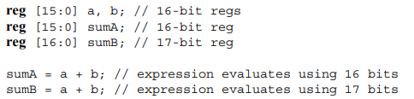
Bitwidth Problem
Rule
During the evaluation of an expression, interim results shall take the size of the largest operand (in case of an assignment, this also includes the left-hand side)
Notes:
https://www.eg.bucknell.edu/~csci320/2016-fall/wp-content/uploads/2015/08/verilog-std-1364-2005.pdf

Slide 14
logic [15:0] a, b, answer; // 16-bit regs
assign answer = (a + b) >> 1; //will not work properly
//中間值計算只用16bit, carry bit 會在 做 >>1 前 就被忽略
assign answer = (a + b + 0) >> 1; //will work correctly
//better way
logic [16:0] answer_w;
assign answer_w = (a + b) >> 1; //wider bitwidth declaration
////////////////////////////////////////////
//assume only needs top 4-bits results
logic [3:0] c, d, answer_msb;
logic [7:0] tmp_w;
assign answer_msb = a * b; //only the lower 4bits remained, error
assign tmp_w = a * b;
assign answer_msb = tmp_w[7:4]; //correct

Slide 15
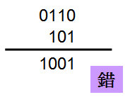
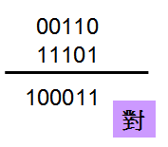
Overflow (Optional)
Normal Condition (沒有Overflow)
(+6) + (-3) = (+3)
故意使用4 bit的+6與3 bit的-3相加，若直接將兩個signed值相加，答案為-7
因為4 bit與3 bit相加，結果可能進位到5 bit，正確的作法是將4 bit的+6做signed extension到5 bit，且3 bit的-3也要做signed extension到5 bit後，然後才相加，若最後進位到6 bit，則不考慮6 bit的值‧

Slide 16
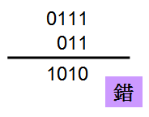
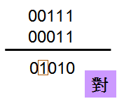
Boundary Condition (正Overflow)
(+7) + (+3) = (+10)
故意使用4 bit的+7與3 bit的+3相加，若直接將兩個signed值相加，答案為-6
+7與+3必須做signed extension才能相加，這樣才能得到正確答案+10‧
+10必須動到5 bit才能顯示，若輸出的值域為4 bit，只能-8 ~ +7，+10很顯然已經正overflow了
若只能以4 bit表示，因為是正的，MSB必須是0(SUM[3]=0)，所以若MSB是1就表示由進位而來，也就是正overflow了(此例的SUM[3]為1，所以已經正overflow)，再加上因為目前運算結果為5 bit，且是正，所以SUM[5]必須為0。
也就是說，若SUM[5]=0且SUM[4]=1時，為正overflow，所以01010對於4 bit來說，是正overflow。
Notes:
若只能以4 bit表示，因為是正的，MSB必須是0(SUM[3]=0)，所以若MSB是1就表示由進位而來，也就是正overflow了(此例的SUM[3]為1，所以已經正overflow)，再加上因為目前運算結果為5 bit，且是正，所以SUM[5]必須為0。
也就是說，若SUM[5]=0且SUM[4]=1時，為正overflow，所以01010對於4 bit來說，是正overflow。

Slide 17
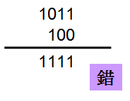
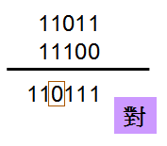
Optional
Boundary Condition (負Overflow)
(-5) + (-4) = (-9)
故意使用4 bit的-5與3 bit的-4相加，若直接將兩個signed值相加，答案為-1
-5與-4一樣必須做signed extension才能相加，這樣才能得到正確答案-9‧進位到6 bit的1要捨去
-9必須動到5 bit才能顯示，若輸出的值域是4 bit，只能-8 ~ +7，-9很顯然已經是負overflow了‧
若只能以4 bit表示，因為是負的，MSB必須是1(SUM[3]=1)，所以若MSB是0就表示由進位而來，也就是負overflow了(此例的SUM[3]為0，所以已經負overflow)，再加上因為目前運算結果為5 bit，且是負，所以SUM[5]必須為1‧
也就是說，若SUM[5]為1且SUM[4]為0時，為負overflow，所以10111對於4 bit來說，是負overflow

Slide 18
m bit + m bit => (m+1) bit
m bit + n bit => (m+1) bit，其中n < m
m bit與n bit都必須先做signed extension到(m+1) bit才能相加
若結果有到(m+2) bit則忽略之，實際的結果為(m+1) bit
若Sum[m+1] ^ Sum[m]為1，表示有overflow
若Sum[m+1]為0且Sum[m]為1，則為正overflow
若Sum[m+1]為1且Sum[m]為0，則為負overflow

